Slide 1
Sparklines using Tableau

Slide 2
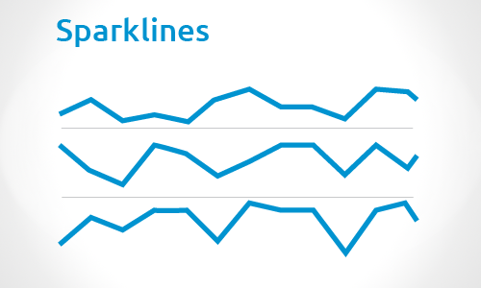

Slide 3
Sparklines:
The term sparkline was introduced by Edward Tufte, a data visualization pioneer.
Sparklines are condensed graphs or charts that can be used in-line with text or grouped to show trends across several different measures.
One of the most effective corporate chart types for quickly communicating trends.

Slide 4
How to create sparklines in Tableau….

Slide 5
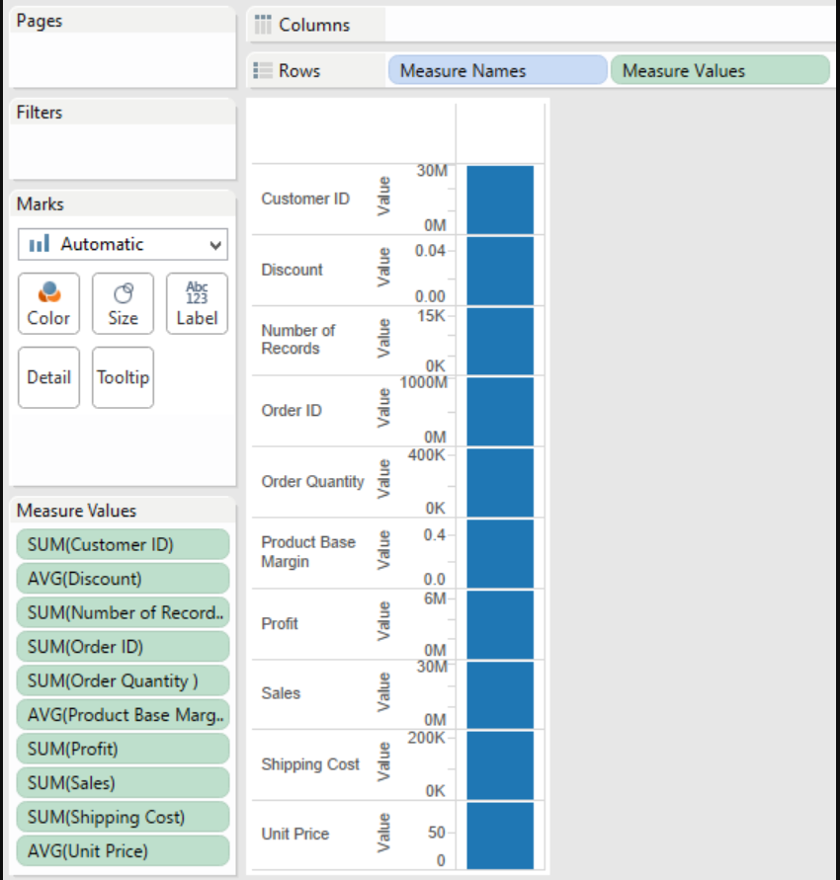
1) Place ‘Measure Names’, then ‘Measure Values’ on your ‘Rows’ shelf.

Slide 6
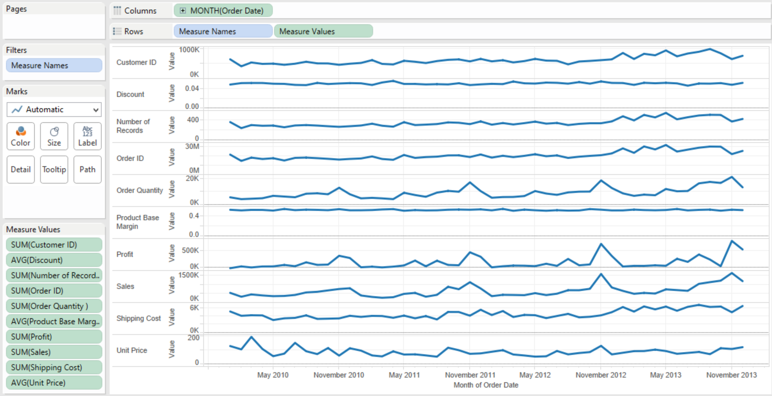
2) Place a date field on the ‘Columns’ shelf.

Slide 7
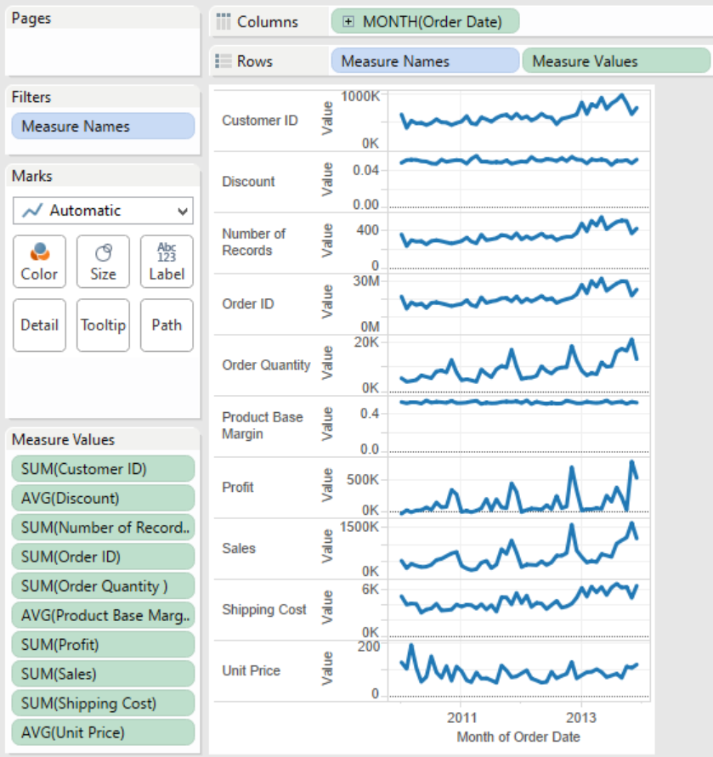
3) Reduce the width of the sparklines view to make the trends pop.

Slide 8
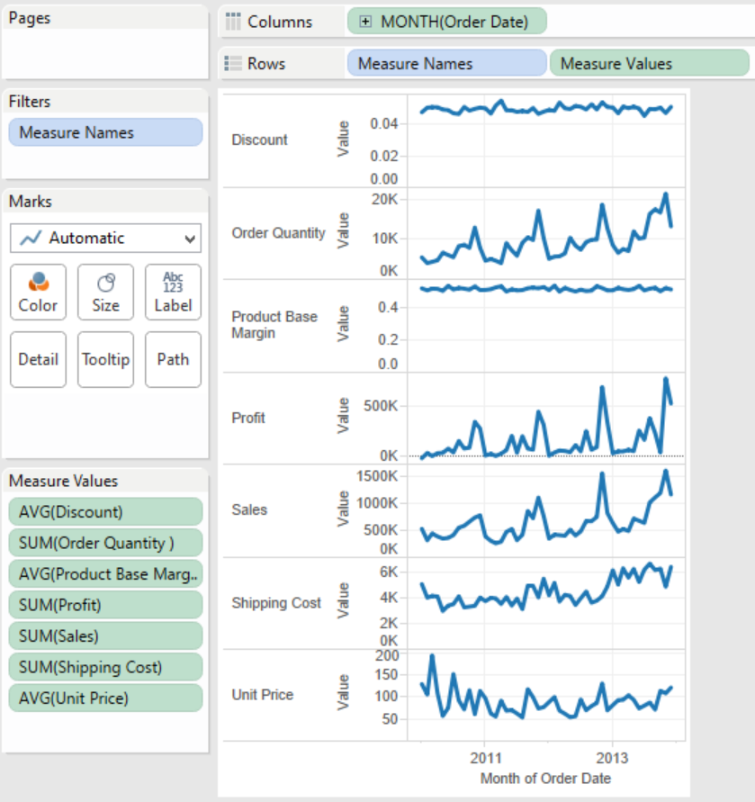
4) Remove irrelevant measures from your view.

Slide 9
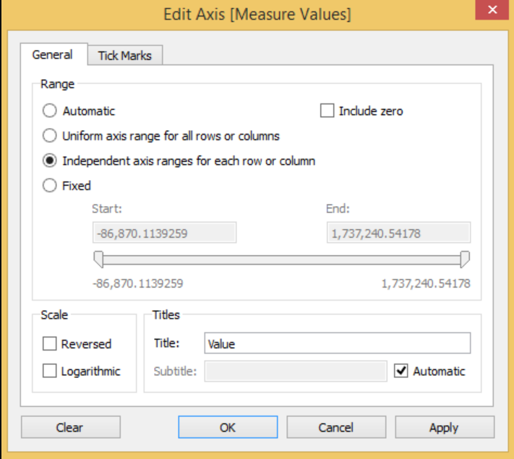
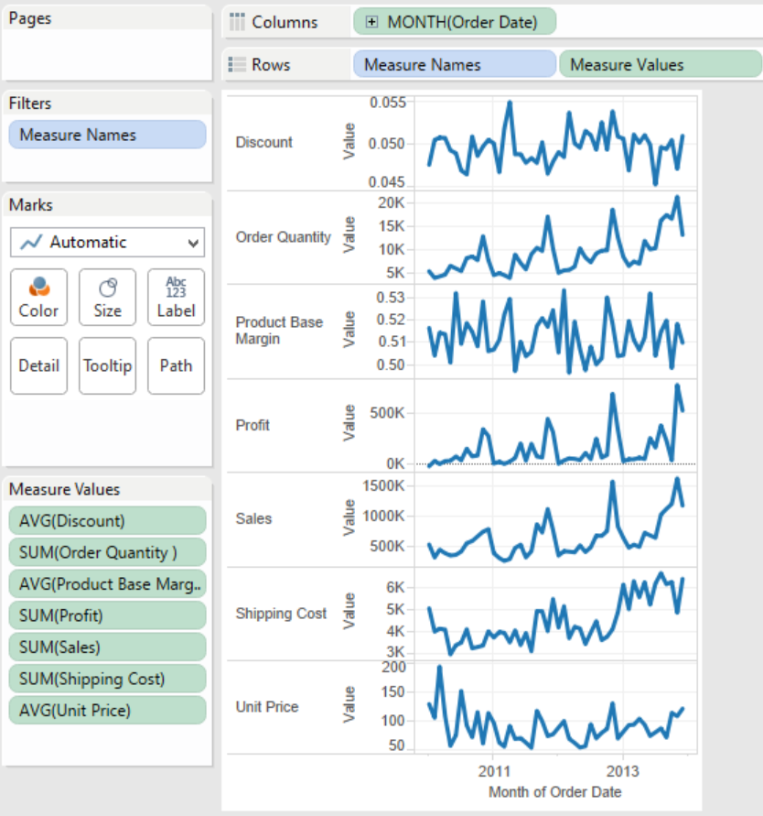
5) Exclude zero from your axes or remove measures that have little to no fluctuation.

Slide 10
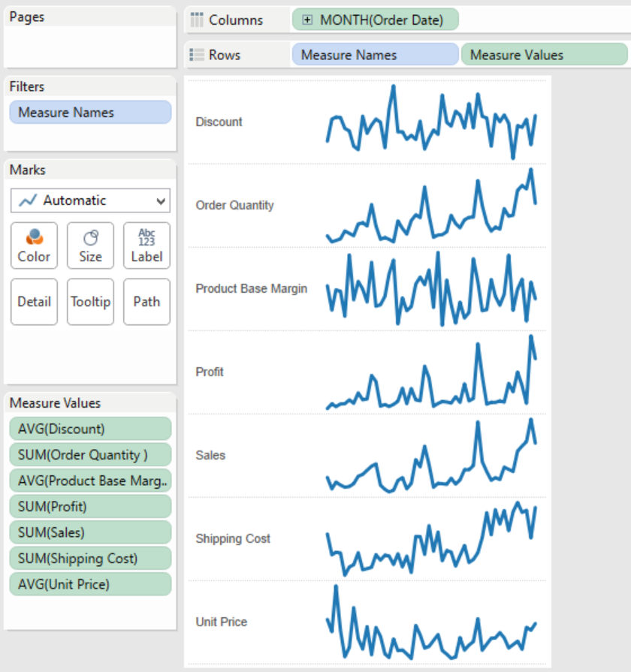
6) Hide axes and format your view
Hide the Y axis by right clicking on the axis and deselecting “Show Header”.

